Slide 1
Ch. 6 Order Management from Kimball and Ross
IDS 521

Slide 2
Key concepts in this chapter
Orders transaction schema
Fact table normalization
Role-playing dimensions
Factors to determine single or multiple dimensions
Junk dimensions for misc. flags
Patterns to avoid with header and line items
Invoicing transaction schema with profit & loss facts
Audit dimension

Slide 3
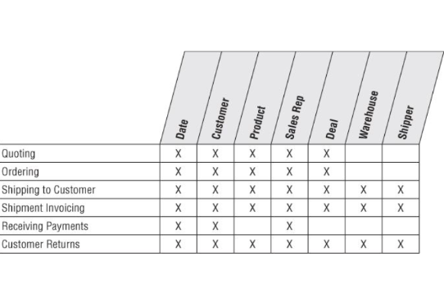
Order management bus matrix
Notes:
Why is this needed? Compared to procurement, retail sales, and inventory? What’s overlapping? What’s different here? What’s the business context; in comparison to what we studied before?

Slide 4
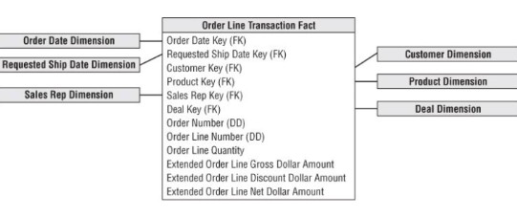
Orders transaction schema
Notes:
Granularity– one row for each line item on an order.

Slide 5
Fact table normalization
What would it mean to normalize facts by a measurement type dimension?
Suppose you started with 10 million order line fact table rows, each with six keys and four facts. If fact rows were normalized, how many fact rows would result?
What if you need to do arithmetic functions between facts? Is it easier with facts in the same row or with normalized facts?
Notes:
Math functions within rows are much easier in relational star schemas (in SQL); in most OLAP cube implementations, computations can cut a cube along any dimension

Slide 6
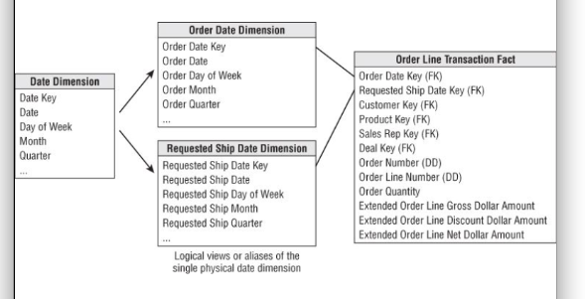
Role-playing dimensions
Notes:
You cannot joint two foreign keys to the same date dimension table; SQL interprets a two-way simultaneous join as requiring both dates to be identical. But you can use a single physical date dimension table for these two views.

Slide 7
Creating Views in SQL
Create View Order_Date (order_date_key, order_day_of_week, order_month, …)
As
Select date_key, day_of_week, month, …
From Date
Create View Req_ship_date (Req_ship_date_key, req_ship_day_of_week, req_ship_month, ...)
As
Select date_key, day_of_week, month, ...
From date
Notes:
SQL supports the concept of aliasing

Slide 8
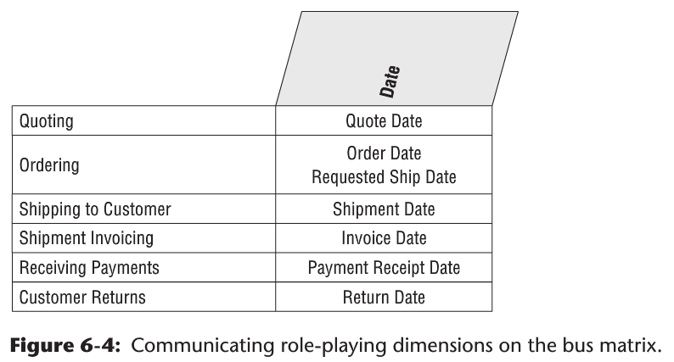
Role Playing and the Bus Matrix

Slide 9
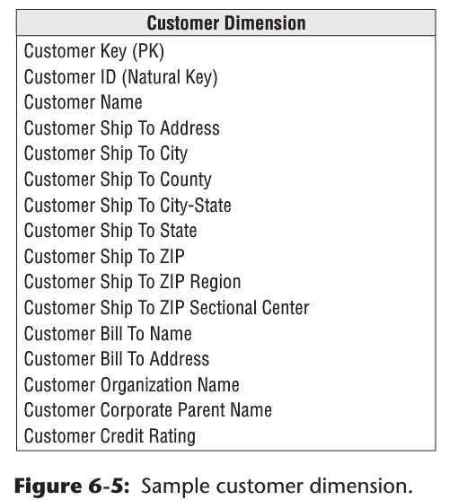
Customer Dimension

Slide 10
Single or multiple dimensions
Suppose that you want to assign a sales representative to customers.
Should this be modeled as a separate dimension, or added to the customer dimension?
Notes:
Draw these out from an order; Customer; Sales organization.

Slide 11
Factors to determine single or multiple dimensions
Is the one-to-one or many-to-one relationship actually a many-to-many?
Does the sales rep and customer relationship vary over time or under influence of another dimension?
Is the customer dimension extremely large?
Do the sales rep and customer dimensions participate independently in other fact tables?
Does the business think about the sales rep and customer as separate things?

Slide 12
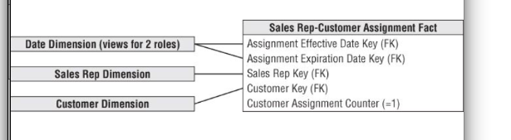
Factless Fact Table for Customer/Rep Assignments
Analyze complex assignment of sales reps to customers over time, even if no order activity has occurred.
Notes:
The coverage table would provide a complete map of the historical assignments of sales reps to customers, even if some of the assignments never resulted in a sale. This fact-less fact table contains dual date keys for the effective and expiration dates of each assignment.
The expiration date on the current rep assignment row would reference a special date dimension row that identiﬁes a future, undetermined date.

Slide 13
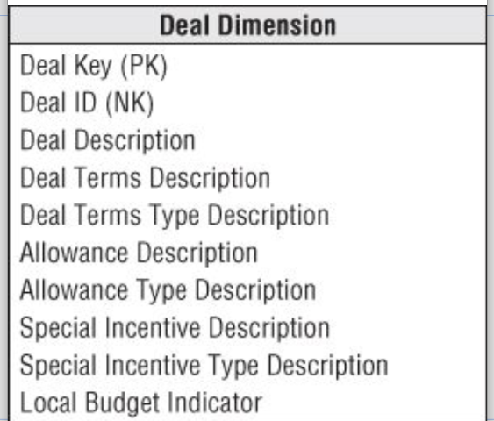
Deal dimension
Also known as the contract.
When should terms, allowances, and incentives be placed in the same or different tables?
Notes:
If these three items are usefully correlated, then package them into a single deal dimension. If uncorrelated, you end up generating the Cartesian product to these factors in the dimension; so it would make sense to split the dimension into separate components.

Slide 14
Degenerate dimension for Order Number
Link the data warehouse back to the operational databases.
Group separate line items on the order; and answer questions like “How many line items on an order, on average?”

Slide 15
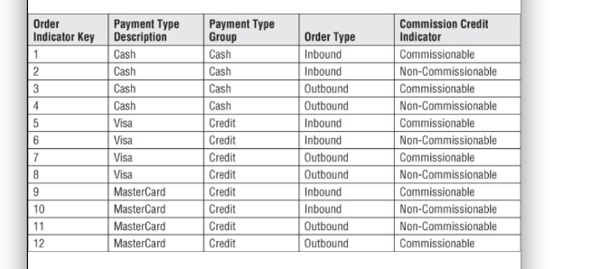
Junk dimensions for misc. flags
A number of miscellaneous indicators and flags; each with a small range of discrete values
Notes:
A junk dimension is a grouping of low-cardinality ﬂags and indicators. By creating a junk dimension, you remove the ﬂags from the fact table and place
them into a useful dimensional framework.
When talking with the business users, we refer to the junk dimension as a transaction indicator or transaction proﬁle dimension.
If a single junk dimension has 10 two-value indicators, such as cash versus credit payment type, there would be a maximum of 1,024 rows.
If you have ﬁve indicators that each take on only three values, a single junk dimension is the best route for these attributes because the dimension has only 243 possible rows.
However, if the ﬁve uncorrelated indicators each have 100 possible values, we’d suggest creating separate dimensions because there are now 100 million possible combinations.

Slide 16
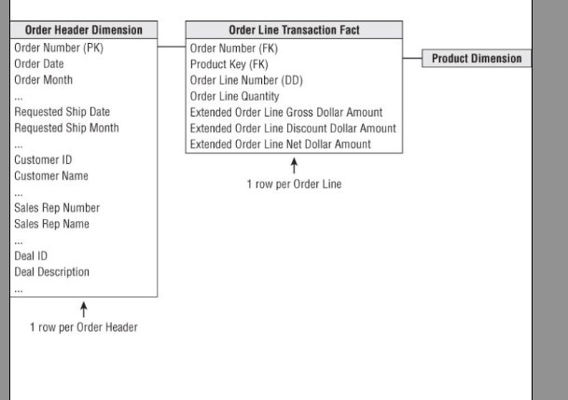
Patterns to avoid with header and line items
Notes:
Problem: the Order Header Dimension table is likely very large relative to the fact table itself. Any analysis of the order’s interesting characteristics, such as the customer, sales rep, or deal involved, would need to traverse this large dimension table.
What is the grain of the fact table?

Slide 17
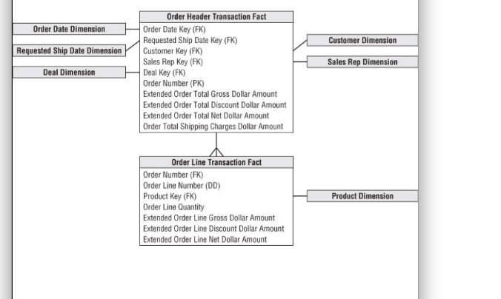
Another header/line pattern to avoid
Notes:
Problem: a large header fact table needs to be associated with an even larger fact table.

Slide 18
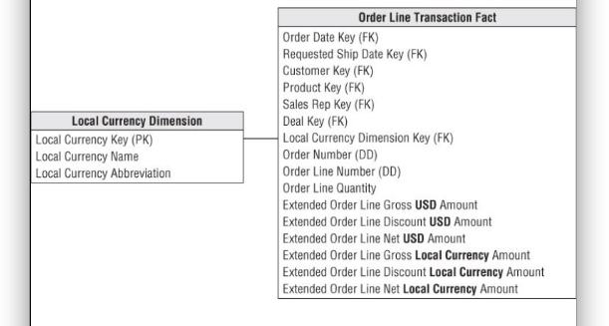
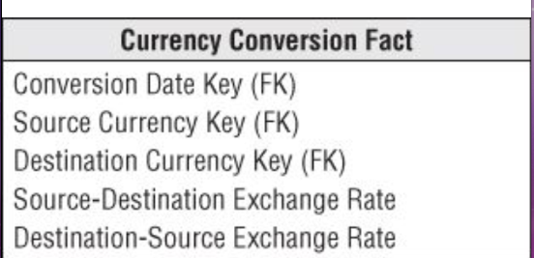
Multiple currencies
Notes:
intra-row extrapolation can be done in a view behind the scenes; use currency conversion fact when managers in any country want to see order volume in any currency.

Slide 19
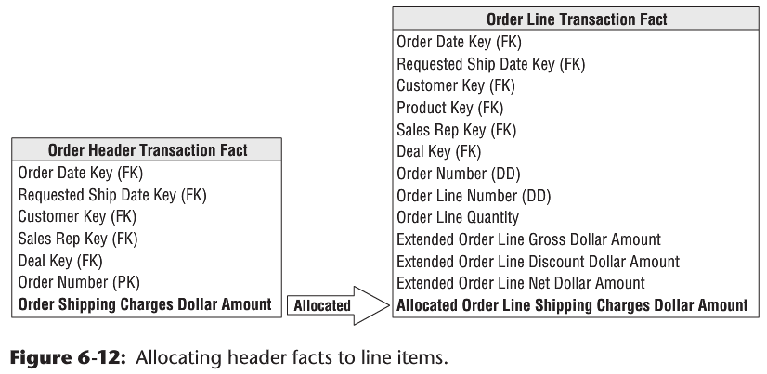
Transaction facts at different levels of granularity
Notes:
It’s useful to force all facts down to the lowest level. Don’t mix fact granularities within a single fact table. But it could be difficult for different departments to agree on how to do this.

Slide 20
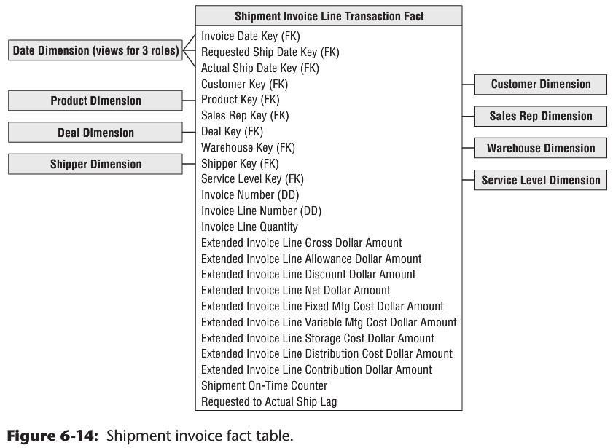
Invoicing transaction schema with profit & loss facts
Notes:
Invoices combine customers, products, and components of profitability. Good place to start for a DW/BI project. To the customer on the invoice: qty shipped, and extended amounts (unit rates multiplied by the qty shipped), including gross amount, deal-related allowance amount, discount amount, net amount. Also, bottom line contribution items, for internal use: fixed manufacturing cost, variable mfr cost, storage cost, distributino cost, contribution amount= net invoice-all costs. Now you can view PNL amount many different filters and dimensions! But not easy to capture all the cost facts; may require 10 different extracts and transformations from different systems.

Slide 21
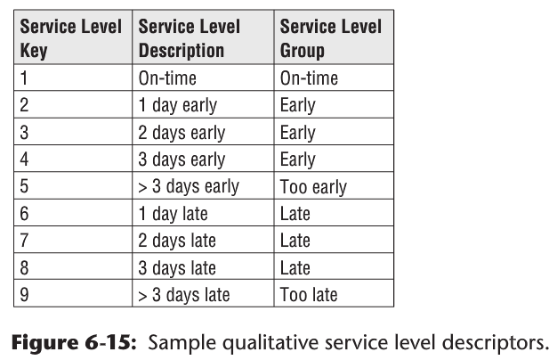
Service level
Notes:
Include a qualitative assessment of performance.

Slide 22
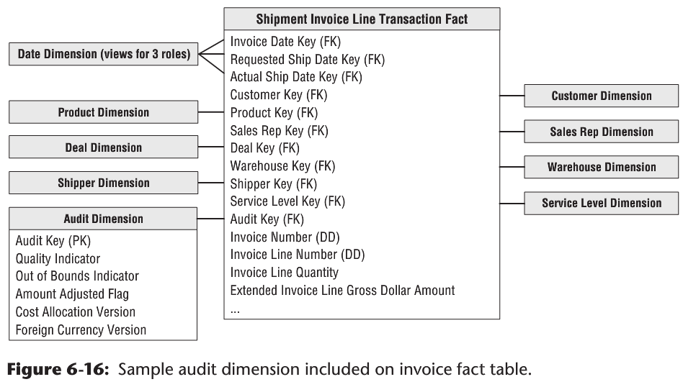
Audit dimension
Notes:
Keep track of: confidence in reported numbers, anomalous values encountered while processing data, version of cost allocation logic used in calculations, and version of foreign currency conversion rules.

Slide 23
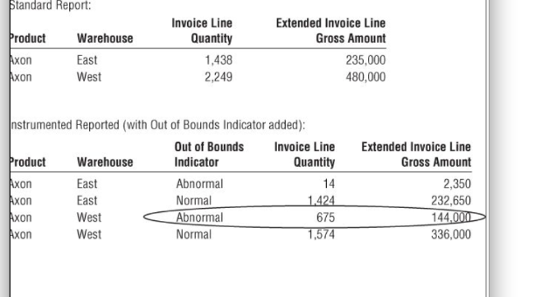
Audit dimension attribute on a standard report
Notes:
The audit dimension provides some powerful queries that can be performed. You might want to take this morning’s invoice report and ask if any of the reported numbers were based on out-of-bounds measures. Because the audit dimension is now just an ordinary dimension, you can add the out-of-bounds indicator to your standard report to see multiple rows, showing normal and abnormal out-of-bounds results.

Slide 24
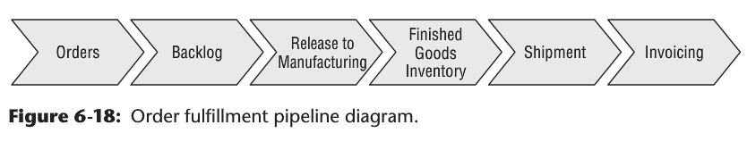
Accumulating snapshot for order fulfillment
Notes:
Order management as a pipeline. Revisit the tables we already have covered here– transaction tables in this process. How else can we model this process? Pros and cons of considering each of these as separate transaction fact table. Would a periodic snapshot be useful anywhere here? 1) Periodic: amount of product flowing through a pipeline spigot during a specified interval, and Avg amount of product sitting in each step of the pipeline in each day. 2) Accumulating: current state of an order; product movement velocities; avg number of days to move between milestones. lag calculations.

Slide 25
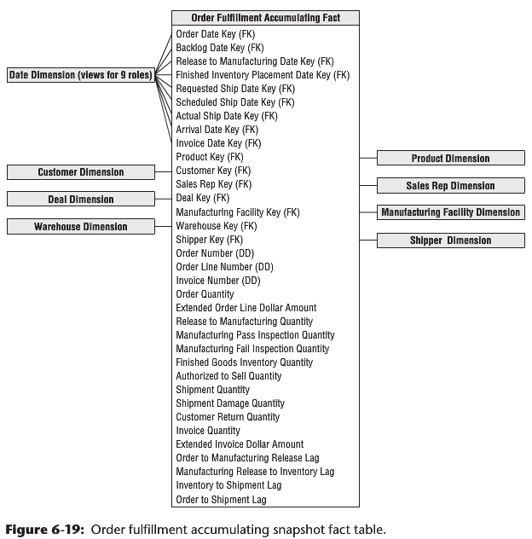
Order fulfillment accumulating snapshot fact table
Notes:
The accumulating snapshot complements alternative schemas’ perspectives of the pipeline.
If you’re interested in understanding the amount of product ﬂowing through the pipeline, such as the quantity ordered, produced, or shipped, transaction schemas monitor each of the pipeline’s major events.
Periodic snapshots would provide insight into the amount of product sitting in the pipeline, such as the backorder or ﬁnished goods inventories, or the amount of product ﬂowing through a pipeline spigot during a predeﬁned interval.
The accumulating snapshot helps you better understand the current state of an order, as well as product movement velocities to identify pipeline bottlenecks and inefficiencies. If you only captured performance in transaction event fact tables, it would be wildly difficult to calculate the average number of days to move between milestones.

Slide 26
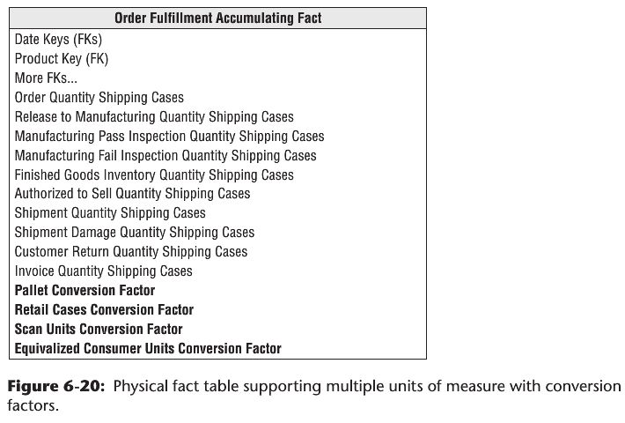
Multiple Units of Measure
Notes:
Designers are tempted to bury the unit-of-measure conversion factors, such as ship case factor, in the product dimension. Business users are then required to
appropriately multiply the order quantity by the conversion factor. Obviously, this approach places a burden on users, in addition to being susceptible to
calculation errors. Moreover, the conversion factors may change over time, so users would also need to determine which factor is applicable at a speciﬁc point in time.
Rather than risk miscalculating the equivalent quantities by placing conversion factors in a dimension table, they should be stored in the fact table instead. In the
orders pipeline fact table, assume you have 10 basic fundamental quantity facts, in addition to ﬁve units of measure. If you physically store all the facts expressed in the different units of measure, you end up with 50 (10 × 5) facts in each fact row. Instead, you can compromise by building an underlying physical row with 10 quantity facts and 4 unit-of-measure conversion factors. You need only four conversion factors rather than ﬁve because the base facts are already expressed in one of the units of measure. The physical design now has 14 quantity-related facts (10 + 4).

